Slide 1
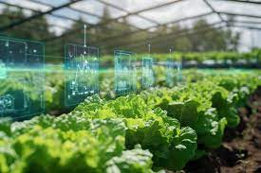
Transforming Agriculture, Empowering Communities, Securing the Future

Slide 2
The Challenges
Low Agricultural Productivity
Rising Food Insecurity
Weak Value Chains
Lack of Market Integration and Export Readiness
Limited Access to Financing
Lack of Innovativeness
Climate change and environmental degradation

Slide 3
VALUE PROPOSITION
Revolutionizing Agriculture
Through
Sustainable Practices
Creating structured value chains and premium market access
Leveraging technology to modernize farming and processing
Implementing organic and eco-friendly farming methods
Providing training and capacity building for farmers and value chain actors
Offering financing and resourcing leverages to members
Driving policy advocacy for agricultural transformation

Slide 4
Who We Are - FOFAPA
A robust and vibrant network of farmers, agribusinesses, and stakeholders
Committed to driving Nigeria’s agricultural transformation
Focused on sustainability, inclusivity, and innovation
Bridging the gap between Nigerian farmers, value chain actors and global markets

Slide 5
Our Commitment To a Thriving Future
Mission
Vision
To revolutionize Nigeria’s agricultural sector by advancing sustainable and organic farming practices, fostering innovation, and empowering producers.
To be the leading driver of agricultural transformation in Nigeria, creating a resilient, inclusive, and sustainable agro-economy.

Slide 6
CONCEPTUAL FRAMEWORK
Develop a scalable and replicable model for organic agriculture and value chain integration
STRATEGY
SYSTEM
STRUCTURE
Build a decentralized management system with strong representation across geopolitical zones
Create streamlined processes for member engagement, training, financing, and market integration

Slide 7
Key Pillars Driving Our Impact
Promoting organic and eco-friendly farming systems
Building capacity and empowering farmers, women, and youth
Strengthening value chains and increasing market access
Providing financing and investment support
Driving technology adoption for efficiency and profitability
Boosting food production and economic diversification
Engaging in policy advocacy and global collaboration
Implementing agroecological principles for sustainability
Creating cooperative frameworks for inclusive growth
Enhancing Nigeria’s global competitiveness in agriculture

Slide 8
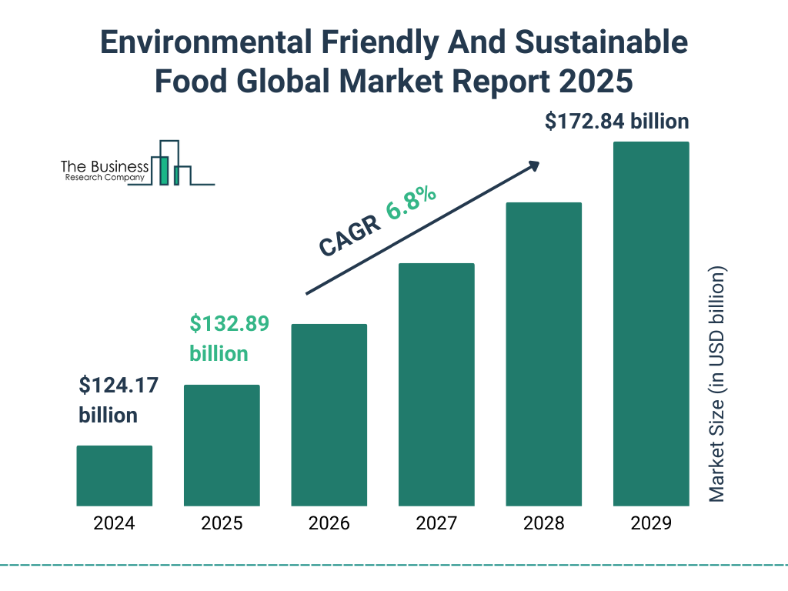
Unlocking Growth in the Agricultural Sector
Nigeria’s organic food market is rapidly expanding
Increasing global demand for sustainably produced food
Government policies supporting agricultural transformation
Rising investment in agribusiness and food security initiatives
Export potential for Nigerian organic produce in international markets

Slide 9
Our Core Areas
Capacity Building & Skills Development
Production & Value Chain Enhancement
Trade & Market Integration
Policy Advocacy & Sustainability
Empowering farmers with training, mentorship, and access to modern technology
Strengthening processing, logistics, and distribution networks
Facilitating access to premium local and global markets
Influencing agricultural policies to support organic and sustainable farming

Slide 10
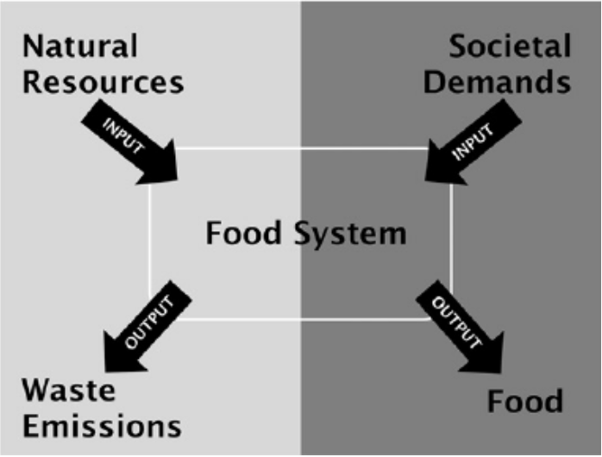
Impact Framework
Integrated agricultural value chain coordination
Sustainable production and resource optimization
Strategic partnerships with industry stakeholders
Technology-driven farming and processing solutions
Cooperative engagement ensuring shared prosperity

Slide 11
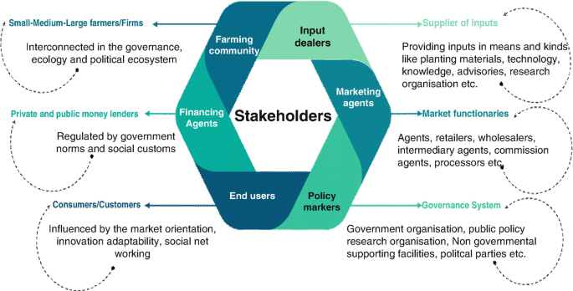
STAKEHOLDER VALUE

Slide 12
MEMBERSHIP
Join Us in Transforming Agriculture
Become a Member –
Empower yourself with resources and networks
Invest in FOFAPA –
Drive growth in Nigeria’s agricultural sector
Partner with Us –
Collaborate to create lasting agricultural impact
Access to a well-structured organic agricultural ecosystem
Strong network of farmers, agribusinesses, and policymakers
Investment and financing opportunities in sustainable agriculture
Contribution to national food security and economic growth
Participation in Nigeria’s transformation into a global organic hub
Contact Information –
https://fogfapron.org
info@fogfapron.org
+234(0)7010168397
+234(0)7061098888
+234(0)8077882306

